Slide 1
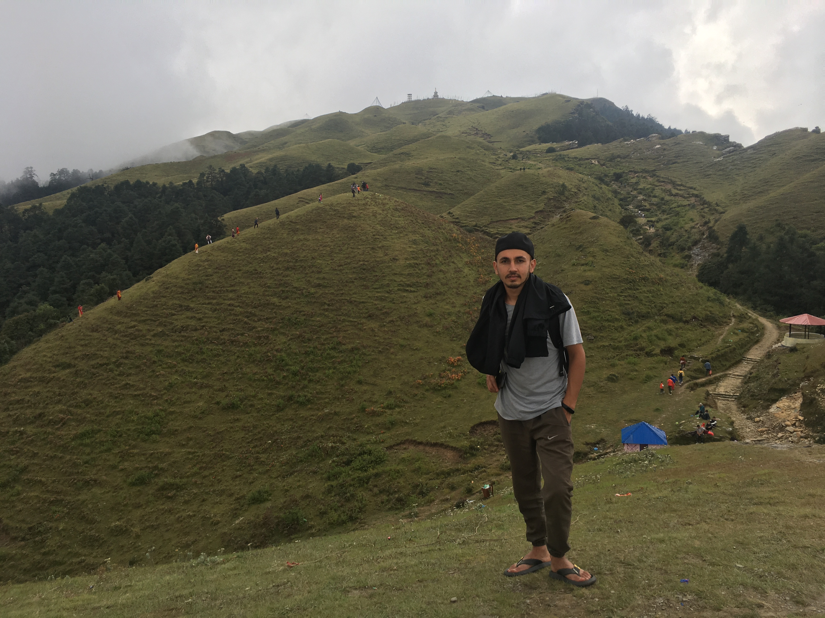
Sujan Thapaliya

Slide 2

FroM Sailung

Slide 3

Interests
Likes to travel
To do nothing

Slide 4
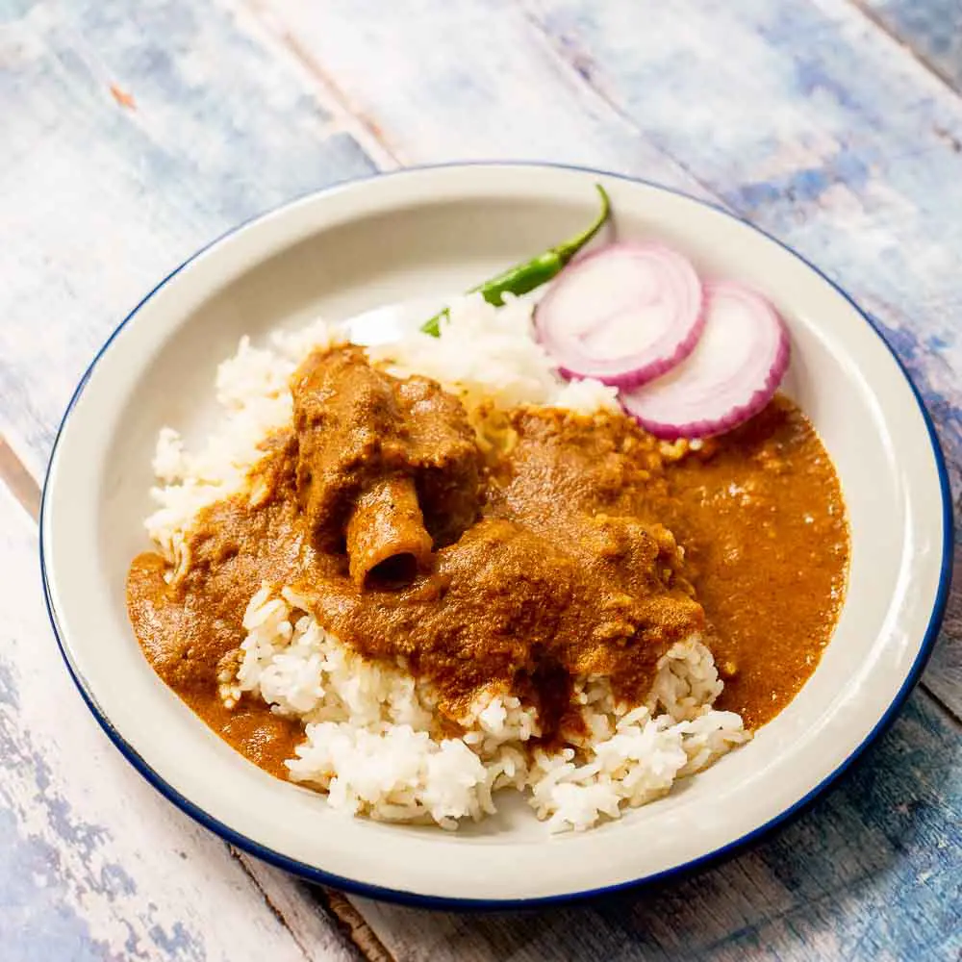
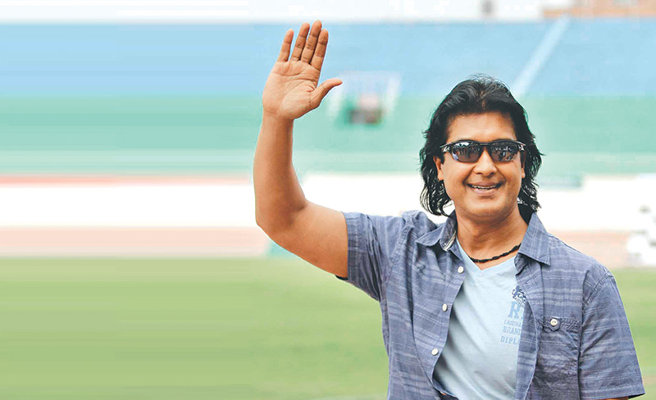
Favorites
Rajesh Hamal
Mutton Curry

Slide 5

Superpower you would like and why
flying
To reach at destination without bikes ,buses, airplane ,rocket

Slide 6

Anything interesting:
Can move ear

Slide 7

Background
Completed Bachelors degree from Nepal Engineering College

Slide 8

Achievement
inter school quiz

